Slide 1
Covid Data Visualization (Africa)

Slide 2
Tool used: Tableau To View this project in Tableau Public: https://public.tableau.com/app/profile/ifunanya.obananya/viz/CovidDataVisualizationAfrica/Story1
About the Dataset
The dataset contains covid data for continents and data breakdown for different countries in each continent. Records include covid cases, new cases and date reported, deaths, population, vaccinations and others. Data Exploration was done using SQL (Covid Project.Sql). (Data source: https://ourworldindata.org/coronavirus)
Challenge Prompt (Recommended Analysis)
What is the total death count and overall covid cases in Africa as compared to other continents?
Which three countries in Africa were mostly affected in terms of death count and overall cases per population?
Identify which country has the highest vaccination count and least vaccination count relative to their overall cases.
Insights
Africa had the second least death count and number of covid cases, with Oceania having the least death count and number of covid cases, and Europe having the highest death count and number of covid cases.
South Africa, Libya and Botswana have the highest infection and death rates.
Cluster Analysis was done. This showed that Morocco has the highest vaccination count relative to their covid cases while South Africa has the highest covid cases but extremely low vaccination count.

Slide 3
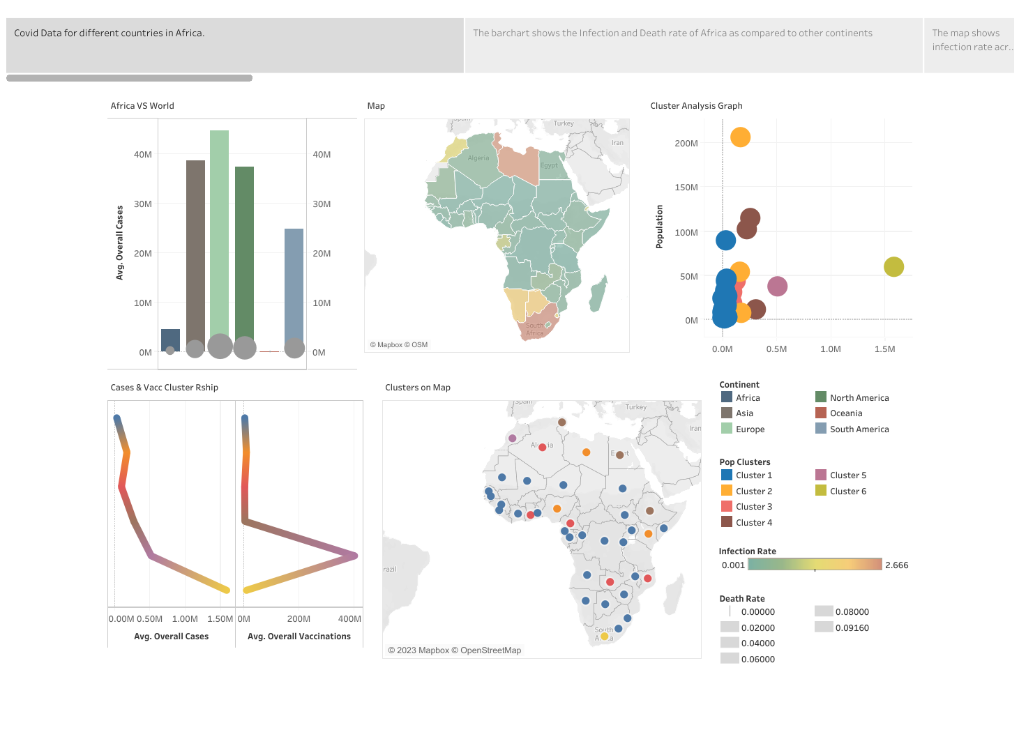

Slide 4
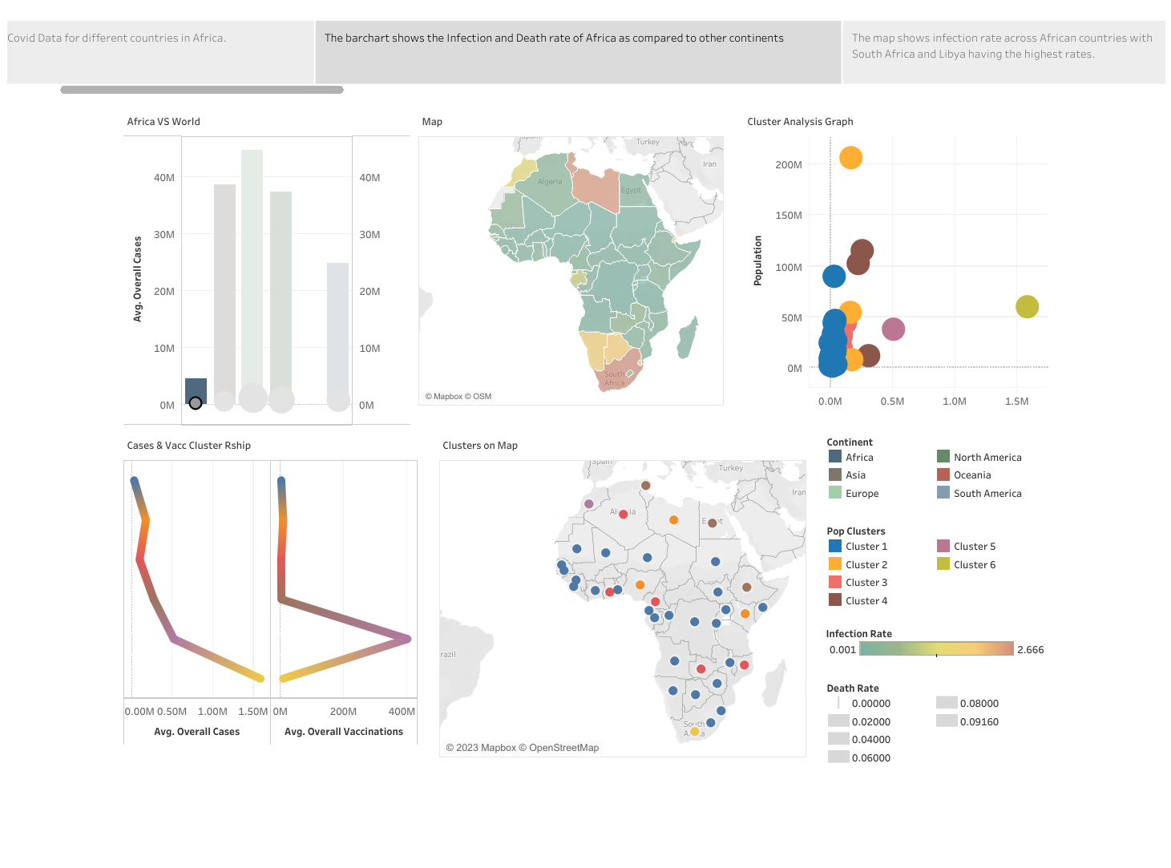

Slide 5
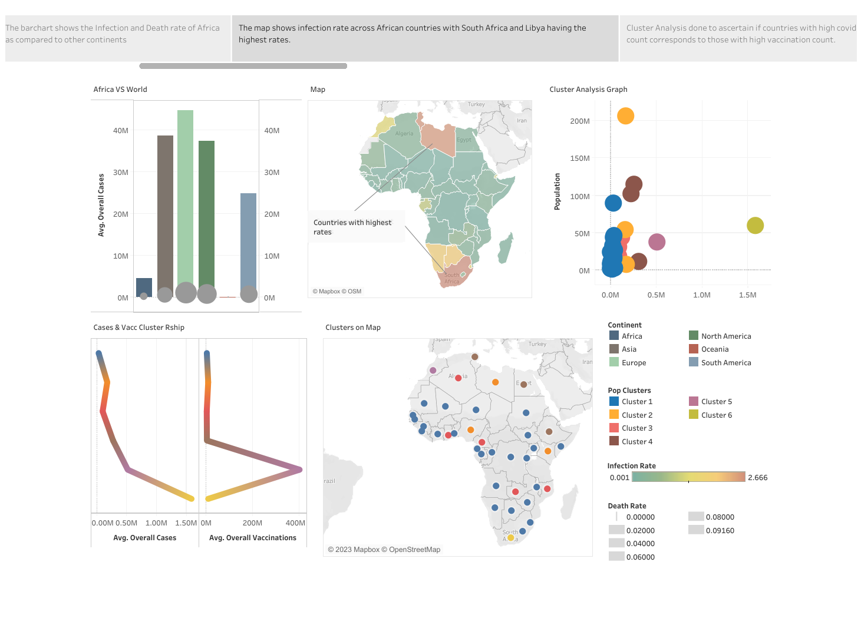

Slide 6
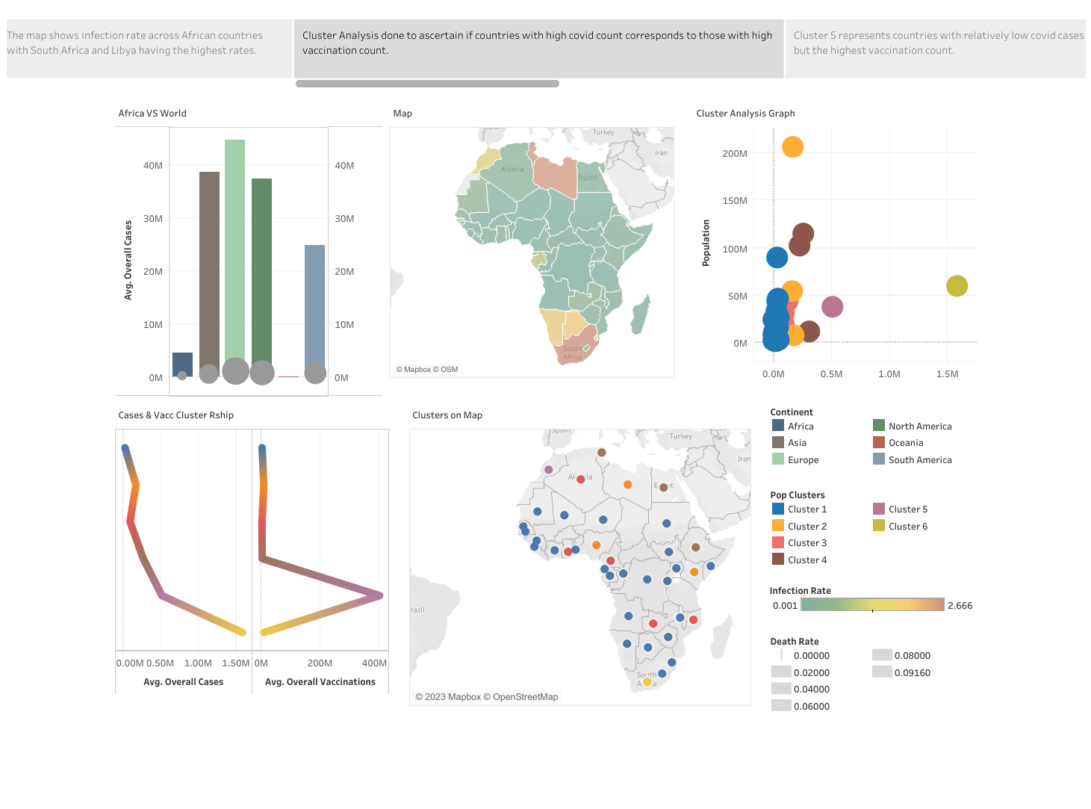

Slide 7
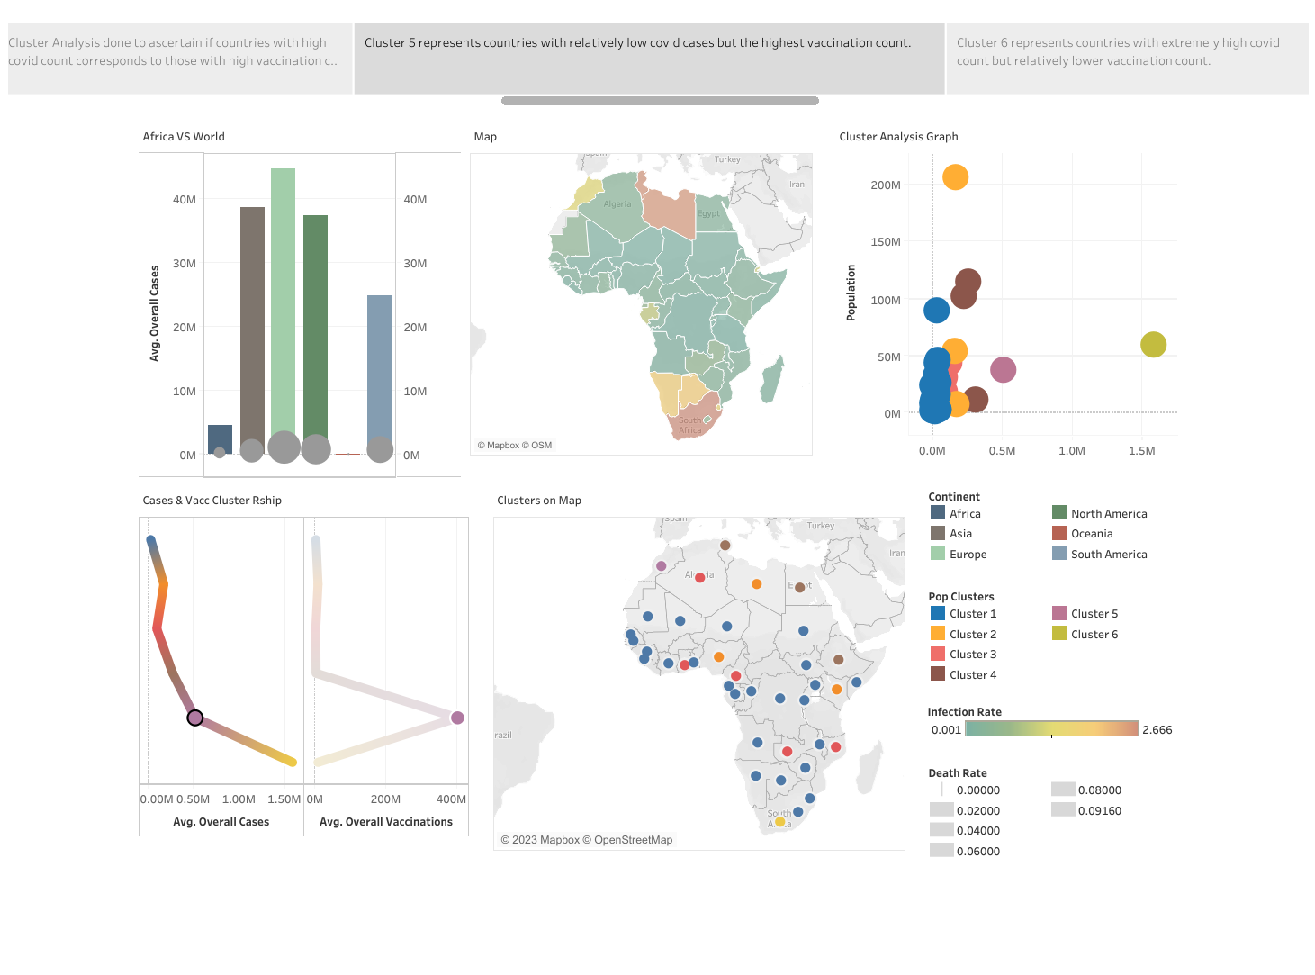

Slide 8
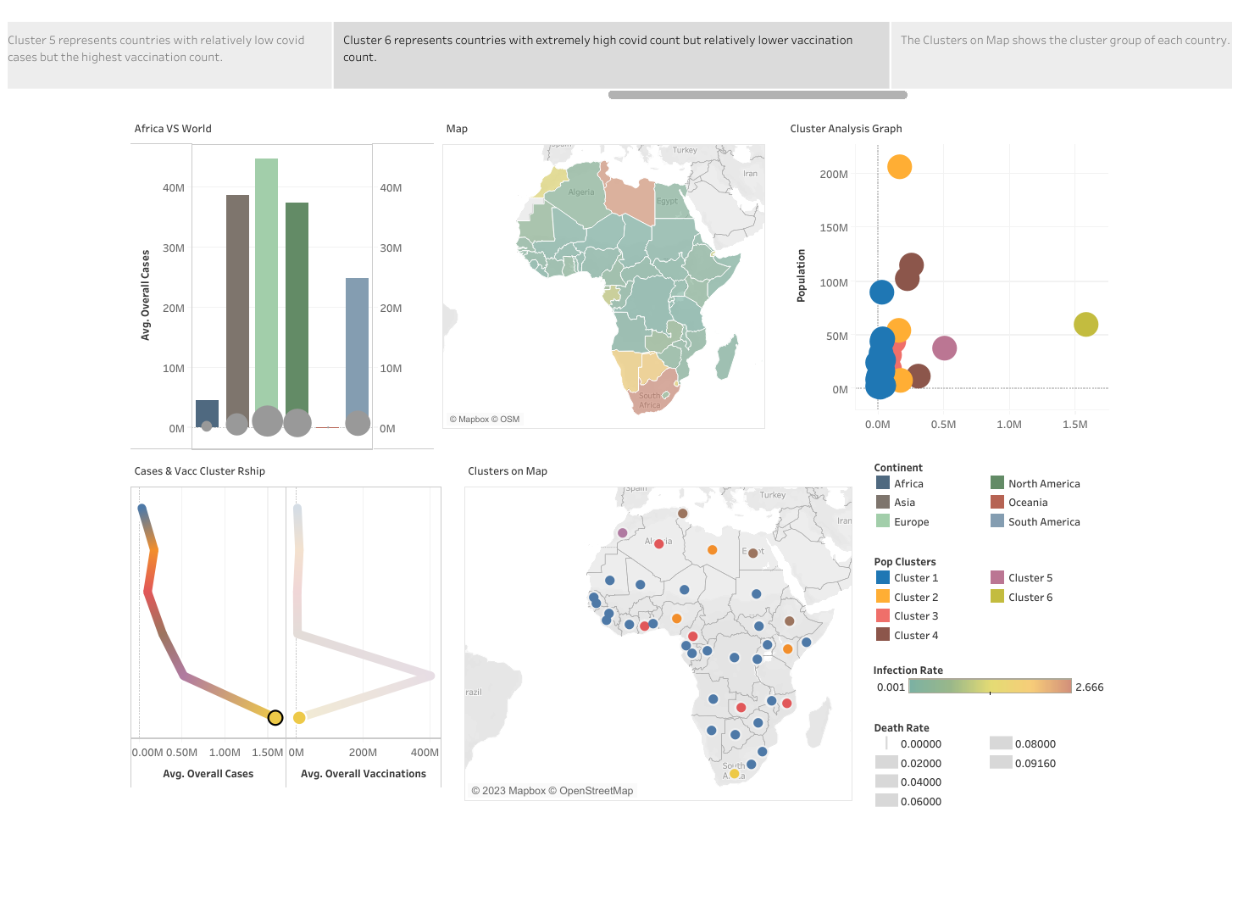

Slide 9
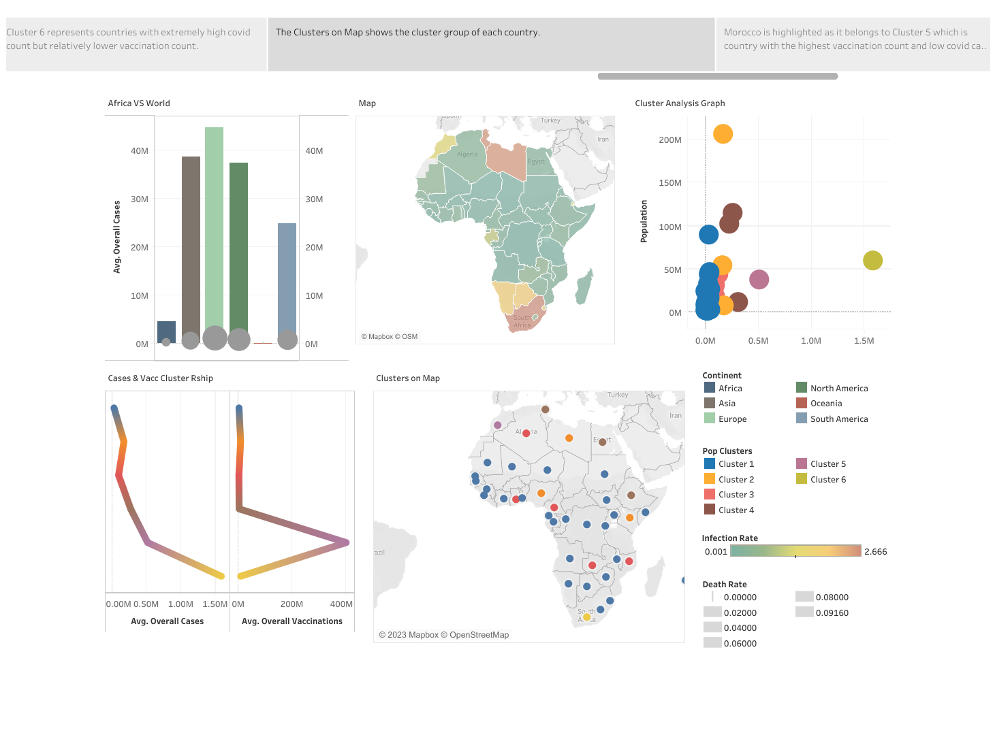

Slide 10
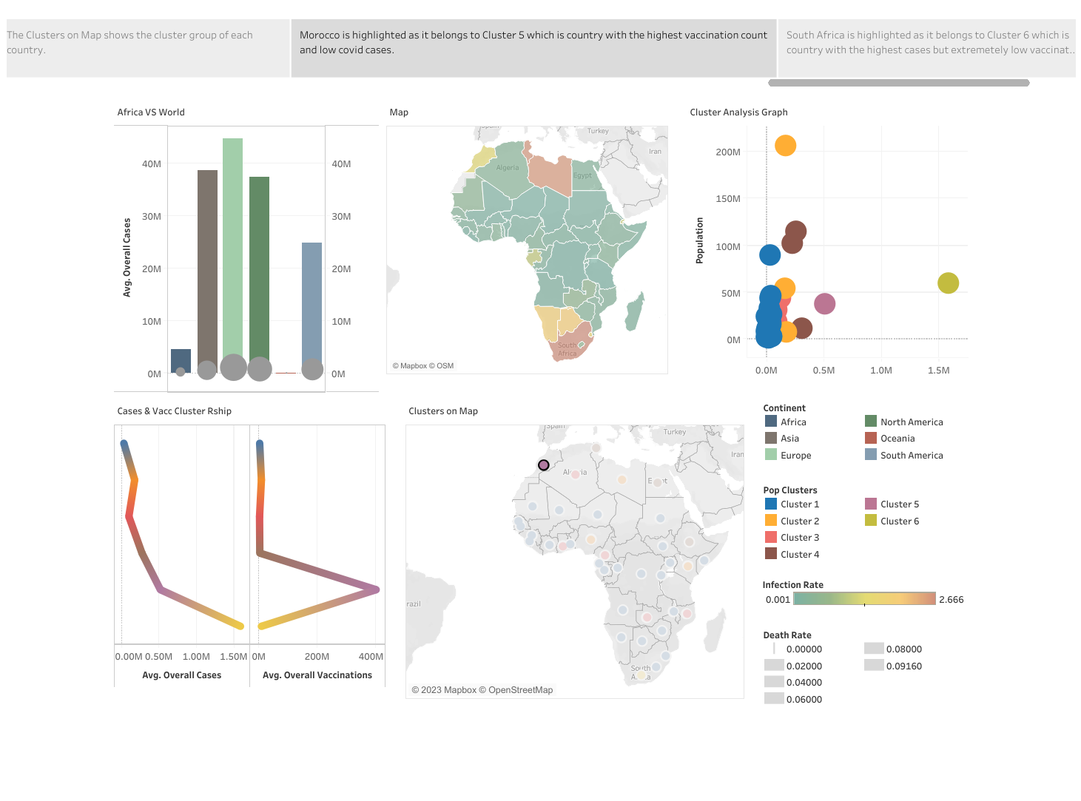

Slide 11
